Slide 1
Presented By:- ________
Submitted To:-_________
College name:-_______

Slide 2
PHP Hypertext Preprocessor
PHP is a server-side scripting language designed for web development but also used as a general-purpose programming language. As of January 2013, PHP was installed on more than 240 million websites and 2.1 million servers. Originally created by Rasmus Lerdorf in 1995, the reference implementation of PHP is now produced by The PHP Group. While PHP originally stood for Personal Home Page, it now stands for PHP: Hypertext Preprocessor, a recursive backronym .
PHP code is interpreted by a web server with a PHP processor module, which generates the resulting web page: PHP commands can be embedded directly into an HTML source document rather than calling an external file to process data. It has also evolved to include a command-line interface capability and can be used in standalone graphical.

Slide 3
INTRODUCTION
The aim of developing Online Food Ordering system project is to replace the traditional way of taking orders with computerized system. Another important reason for developing this project is to prepare order summary reports quickly and in correct format at any point of time when required.
Online Food Ordering System has a very lot of scope. This PHP project can be used by any restaurants or fast foods for customers for keeping their order records. This project is easy, fast and accurate. It requires less disk space. Online Food Ordering System uses MYSQL Server as backend so there is not any chance of data loss or data security.

Slide 4
LANGUAGES USED
PHP For Development
HTML , HTML5 For designing
CSS And CSS3 For style
My SQL For database design
JavaScript For client-side validations
JQuery For client-side Scripting

Slide 5
SYSTEM DESIGN
System Design is the process of developing specifications for a candidate system that meet the criteria established in the system analysis. Major step in system design is the preparation of the input forms and the output reports in a form applicable to the user.
The main objective of the system design is to make the system user friendly. System design involves various stages as:
Data Entry
Data Correction
Data Deletion
Processing

Slide 6
SOFTWARE REQUIREMENT ANALYSIS
The analysis part of designing of the software focuses on the requirement analysis of the software. It is based on studying of what is required from the software, the nature of program to be built, behavior, performance and interface. It is based on studying the existing system.

Slide 7
HARDWARE REQUIREMENTS
PROCESSOR
RAM
DISK SPACE
Pentium IV or above version
512 MB OR Higher
500 MB or above
SOFTWARE REQUIREMENTS
OPERATING SYSTEM
DATABASE
SERVER
WIN-XP,WIN-7 ,WIN-10
MY SQL, MYSQLI
APACHE(WAMP)

Slide 8
Modules of food delivery in php
Admin
Users
Guest users
Users—
User can register yourself.
User can login with valid email and password.
Forgot Password(user Can recover own password)
About the fast food company
The fast food and the services offered there
change Password
Admin–
Admin can create Package
Online purchase
Type of food provided.
Change Password
Admin Dashboard
Guest users
Visit the Website
Guest user can enquiry

Slide 9
OBJECTIVES OF STUDY
1.The home page of this web interfile provides an avenue where customers will be able to gather more and reliable information about what the fast food industry really does.
2.The products and services offered would provide the customers with all the different categories of available products that they can choose and select from.
3.This will provide a user friendly environment between the customer and employee thus increasing the efficiency of the food ordering system.
4.There will also be an online purchase form with which valued customers will be using to get in touch with any of their request whenever the need a rises.
5.It will also help for easy retrieval of orders made by the customers.

Slide 10
STATEMENT OF PROBLEM
As industries are fast expanding, people are seeking for more ways to purchase products with much ease and still maintain cost effectiveness. The vendors need to purchase the products in order to sell to end users. The manual method of going to their local food sales outlets to purchase food is becoming obsolete and more tasking. Food can be ordered through the internet and payment made without going to the restaurant or the food vendor. So there is need for a wide range of publicity and enabling direct order, processing and delivering of food through online system.

Slide 11
SIGNIFICANCE OF STUDY
In view of the rapid development of computer technology in almost all the fields of operation and its use in relation to information management, it has become important to look into the development of online ordering system for firms to meet up with demands of the customers. Therefore, the food ordering and delivery system will help customers and management to:
1. Advertise available foods in their company
2. Reduce the workload in the present system.
3. Reduce time wasted in data processing.
4. Create a platform for online purchase and delivery of fast food.
5. Keep accurate record on purchased order and delivery.

Slide 12
MySQL
MYSQL is a relational database management system (RDBMS) that runs as a server providing multi-user access to a number of databases. It is named after developer Michael Widenius daughter, My. The SQL phrase stands for Structured Query Language.
The MySQL development project has made its source code available under the terms of the GNU General Public License, as well as under a variety of proprietary agreements. MySQL was owned and sponsored by a single for-profit firm, the Swedish company MySQL AB, now owned by Oracle Corporation.
Free-software-open source projects that require a full-featured database management system often use MySQL. For commercial use, several paid editions are available, and offer additional functionality.

Slide 13
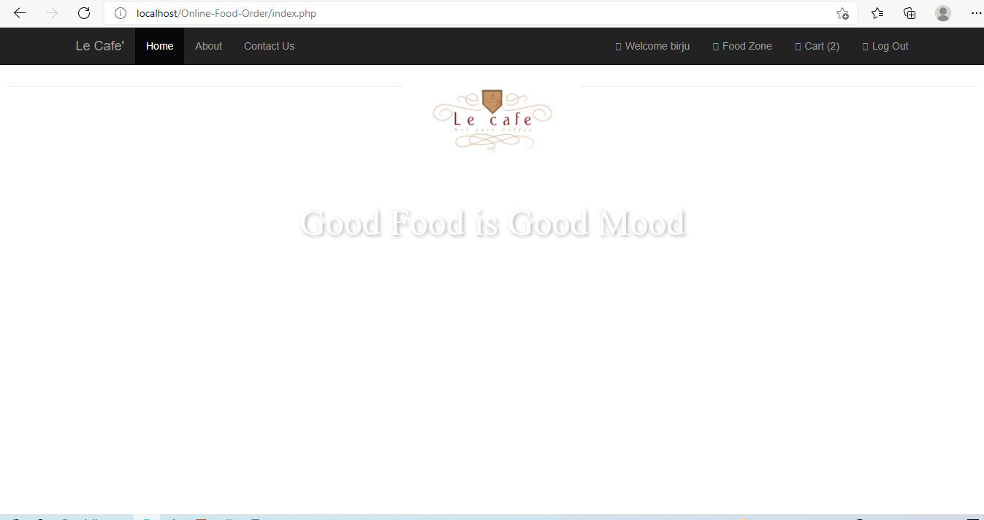

Slide 14
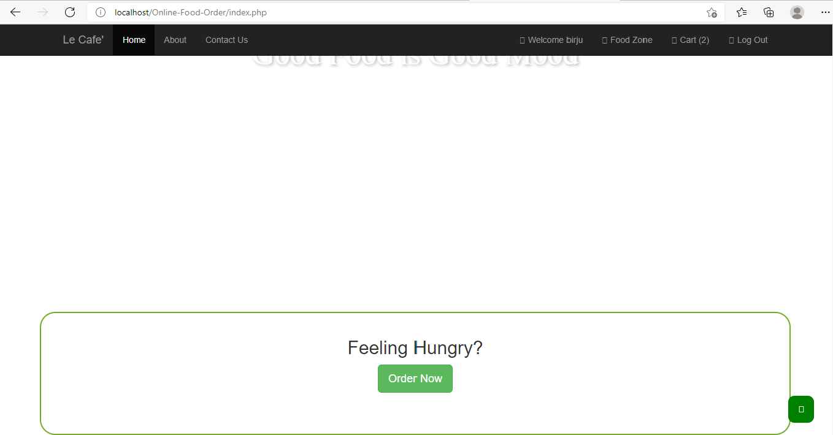

Slide 15
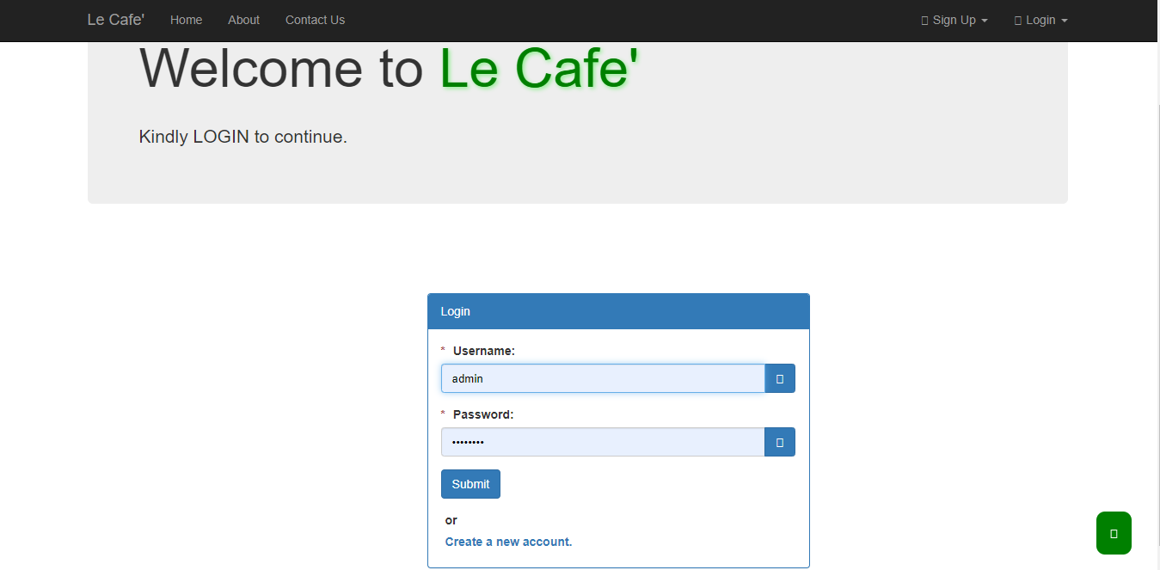

Slide 16
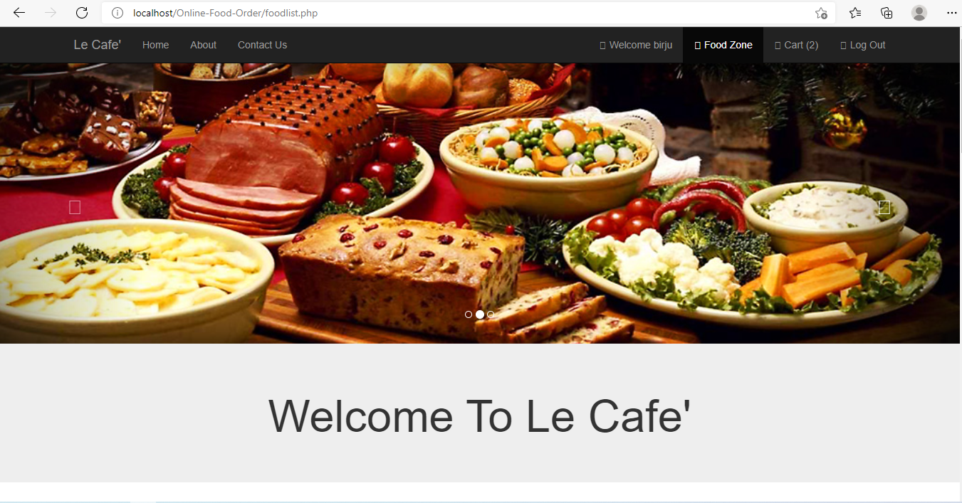

Slide 17
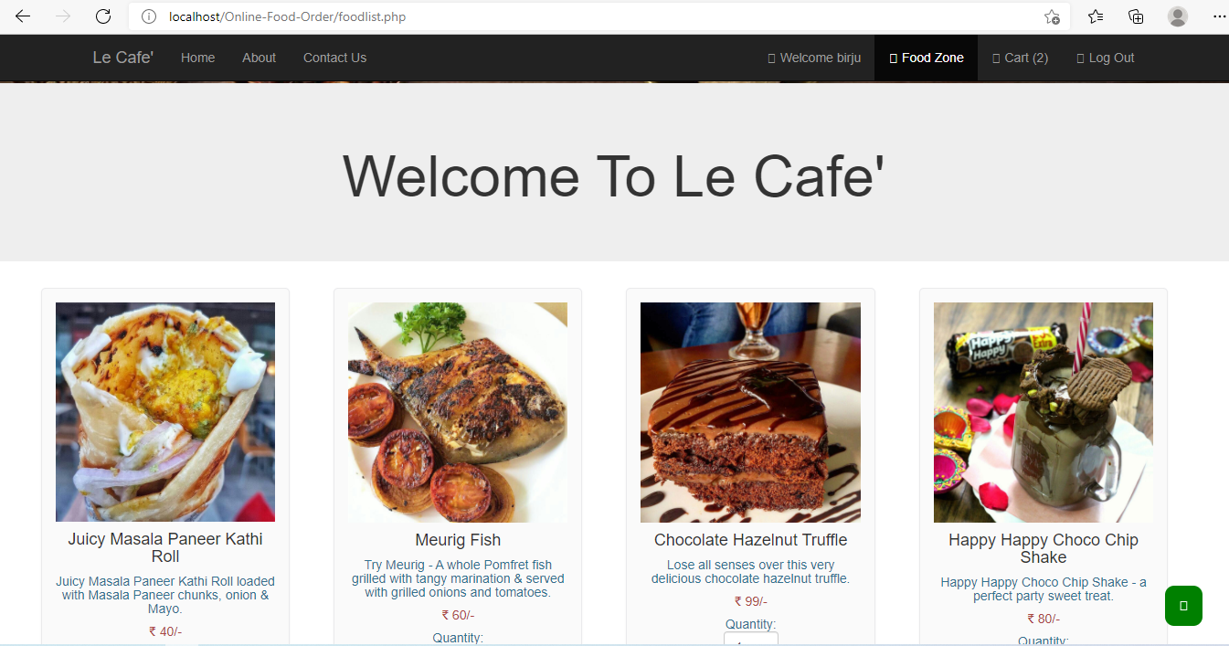

Slide 18
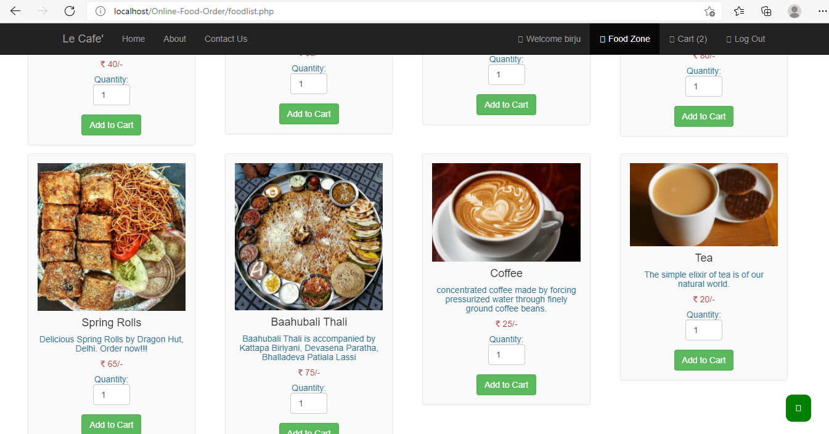

Slide 19
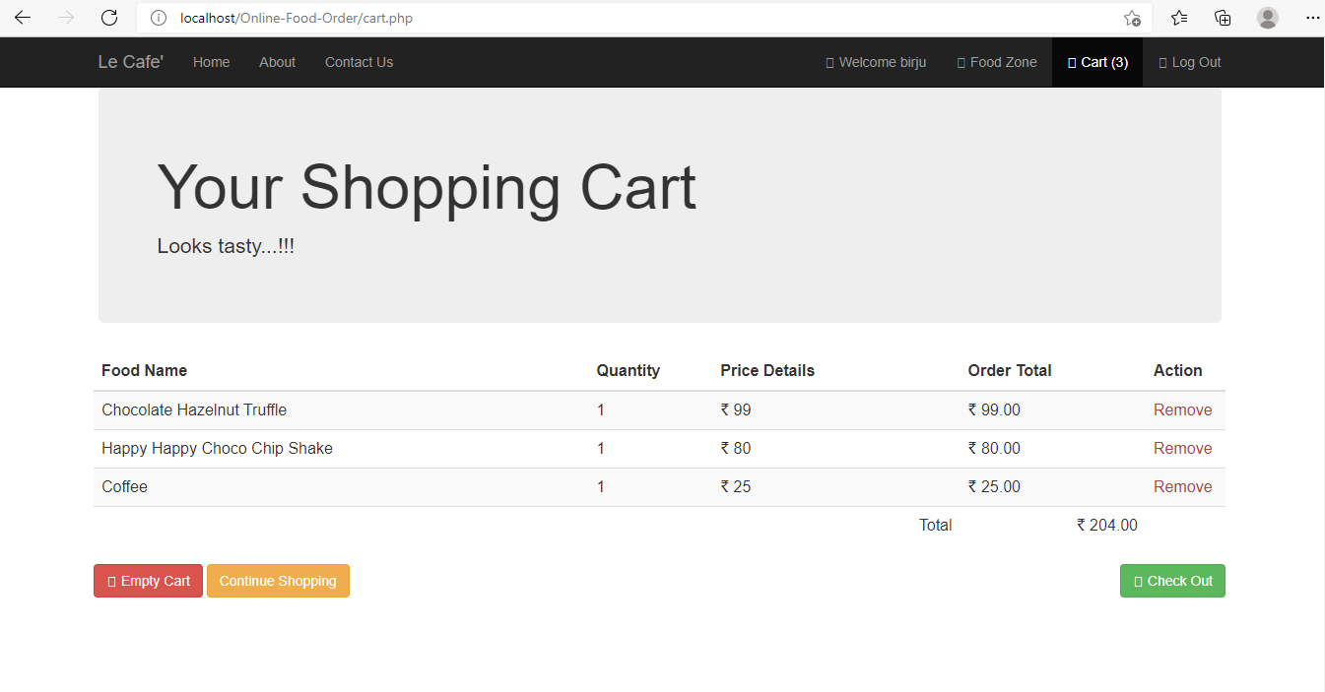

Slide 20
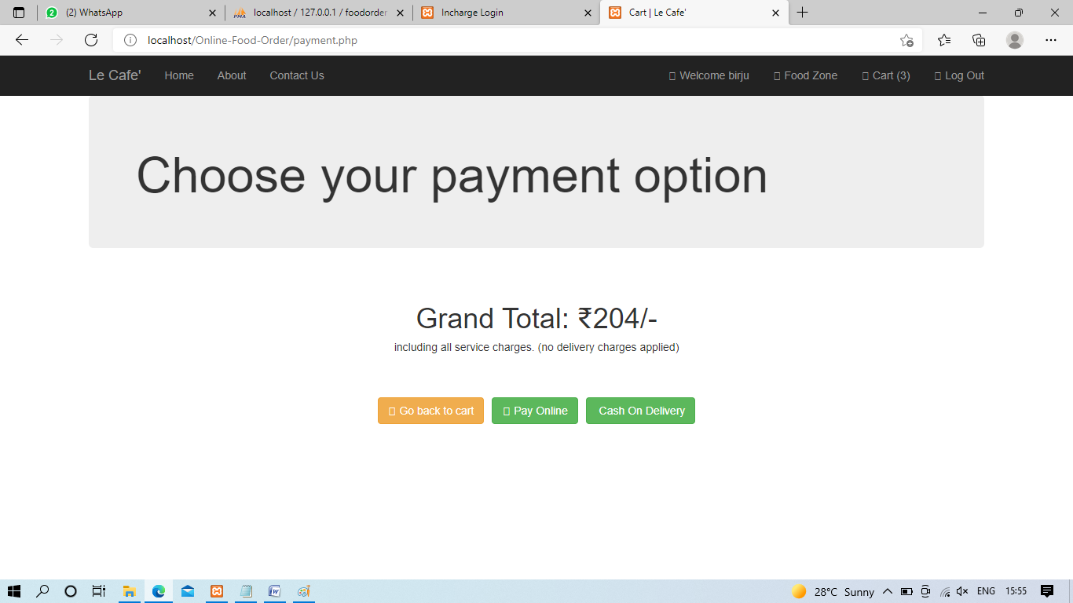

Slide 21
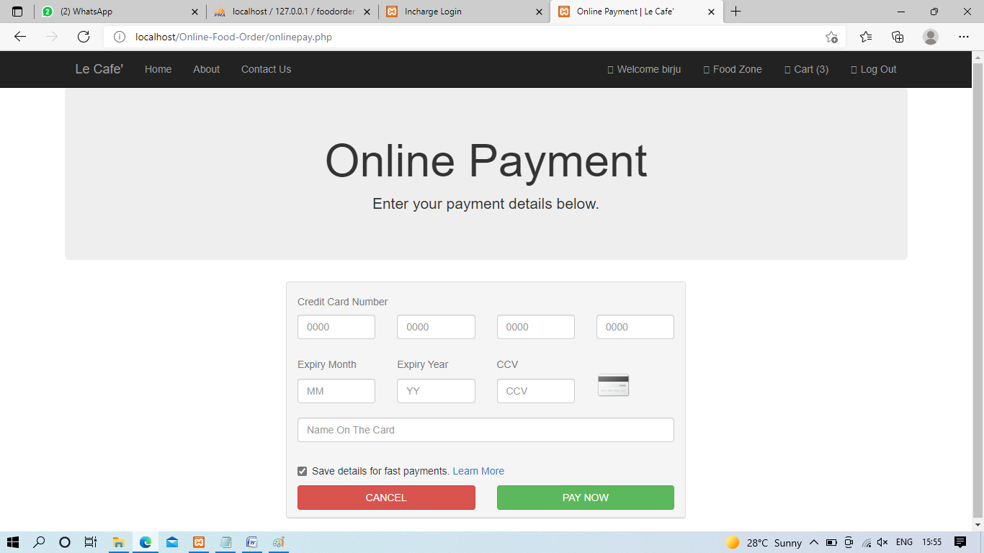

Slide 22
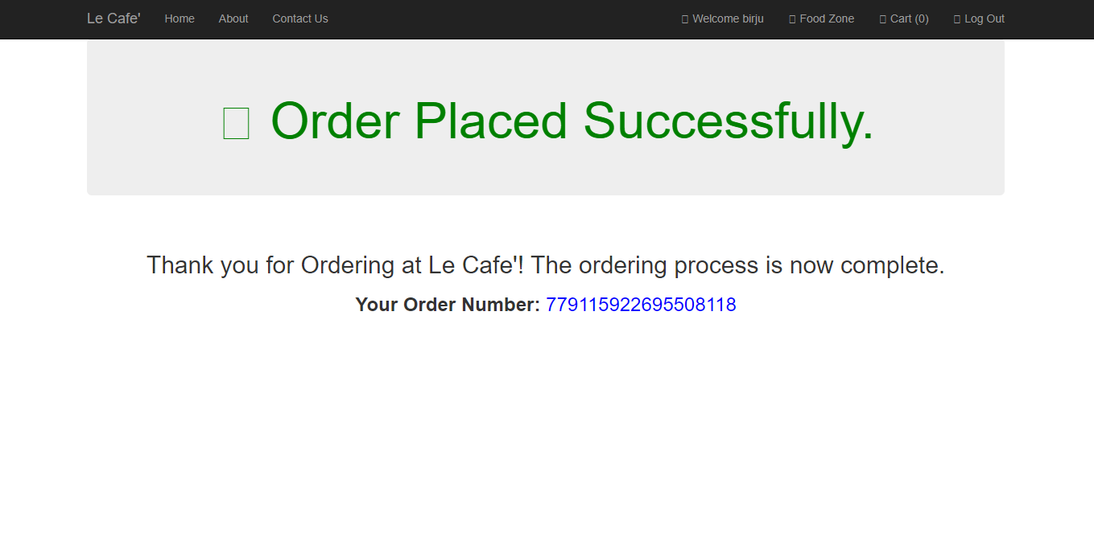

Slide 23
Conclusion
In conclusion I would like to thanks to faculty member of the university
And all my peers for supporting me in the completion of this project.
I would also like to thanks all the teachers of the institute (I.C.M) who
helped me with all the problems that I encountered during the making of
this project.

Slide 24
THANK YOU

